Slide 1
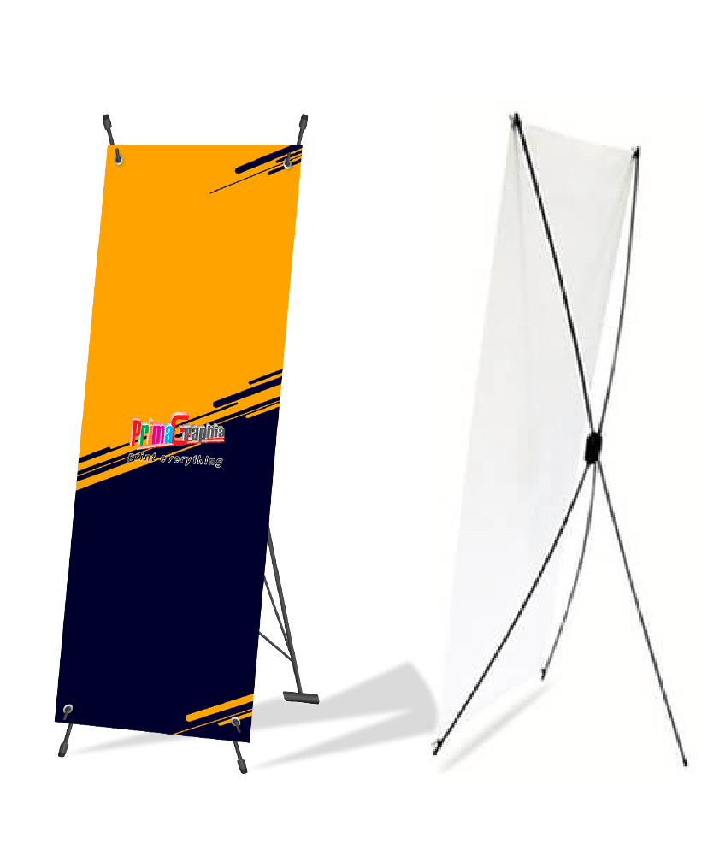
Poster template
ICIESC authors should be prepare poster with format:
  X banner format
  Type material is Polyester (Indoor material)
  Size: 60 x 160 cm
  Poster content: Title, Author, affiliation, Abstract, Introduction, Method, Results, Conclusion, References.
Poster sample:

